Slide 1
Internet Marketing for Local Triratna Groups
By Keith Griggs 23rd Jan 2017

Slide 2
Purpose of this Presentation

Slide 3
Purpose of this Presentation
How to reach out online,

Slide 4
Purpose of this Presentation
How to reach out online,
engage with people,

Slide 5
Purpose of this Presentation
How to reach out online,
engage with people,
express our vision,

Slide 6
Purpose of this Presentation
How to reach out online,
engage with people,
express our vision,
build an online community, that reinforces and complements what we do at our classes

Slide 7
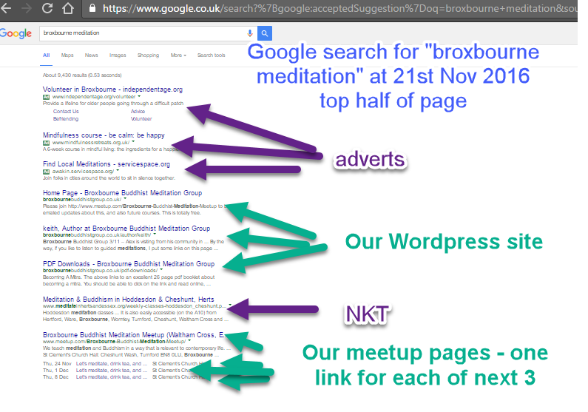
Intended Result – If they google “Broxbourne meditation”, you should have most of the slots in organic results (i.e. ignoring the adverts)

Slide 8
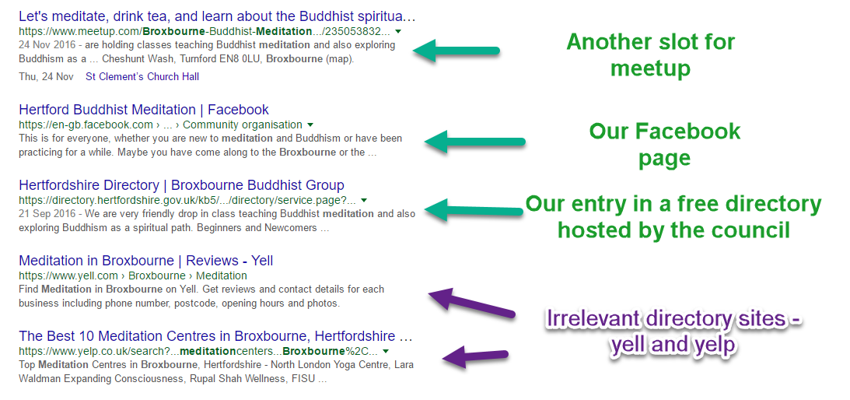
Bottom half of page

Slide 9
Important tip
If you are checking your position on Google, then make sure you log out of your gmail account first
Otherwise it will show you personalised results that are different from what other people see.

Slide 10
Suggested 6 point plan
Set up Meetup.com page
Set up Facebook page
Advertise on Facebook by boosting engaging posts
Create Facebook event and boost it (Leicester got 20 people for £20!)
Get listed on www.thebuddhistcentre.com
Optional: Set up a blog
eg Wordpress site on own domain eg broxbournebuddhistgroup.co.uk
or
Create a blog on Blogger.com that shows up on blogspot.com (easier)

Slide 11
Optional tip - to find keyword volume
To find volume of monthly searches in Google for a keyword
Note “keyword” = a search term or phrase eg “Broxbourne meditation”
Go to adwords.google.com/keywordplanner and quickly set up a free adwords account

Slide 12
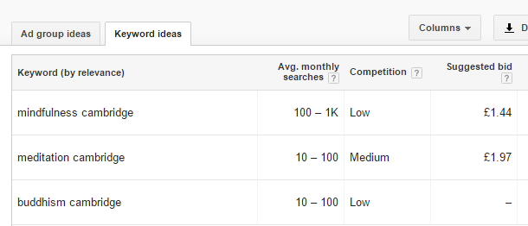
Top tip - keywords
Use keywords such as “Buddhism, Meditation, Mindfulness” in user names, domain names, group names etc,
Info from Google Adwords keyword planner (used to be known as Google keyword tool)
More people search for the word “mindfulness” than “meditation” or “Buddhism”
“meditation” has more competition

Slide 13
Top tip - keywords
Can also add names of nearby villages, towns and suburbs to our pages eg:
“We are easily accessible from the following areas: Broxbourne, Cheshunt, Hoddesdon, Goffs Oak, Waltham Cross, Waltham Abbey, Waltham Forest, Harlow, Enfield, Barnet, Hertford, Ware, Welwyn Garden City, Potters Bar, Hatfield, East Hertfordshire, West Essex”
Because we added that sentence, we now appear on page one for many of these eg on “meditation barnet”
Barnet is the second largest London borough with 331k people

Slide 14
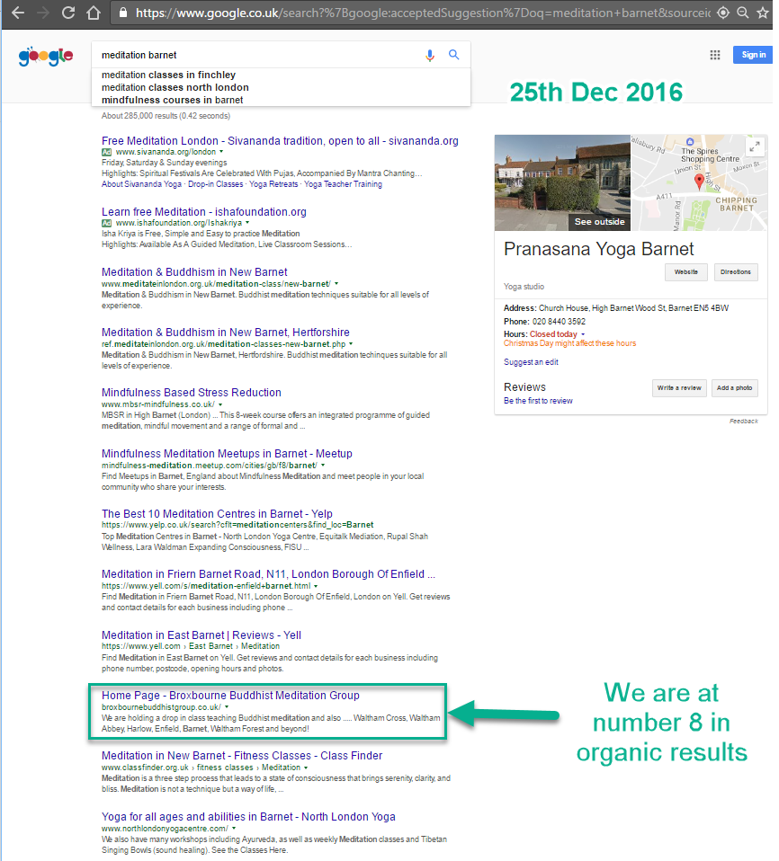

Slide 15
Suggested 4 point plan
Meetup.com

Slide 16
Suggested 4 point plan
Meetup.com
Best results for minimum time effort and money

Slide 17
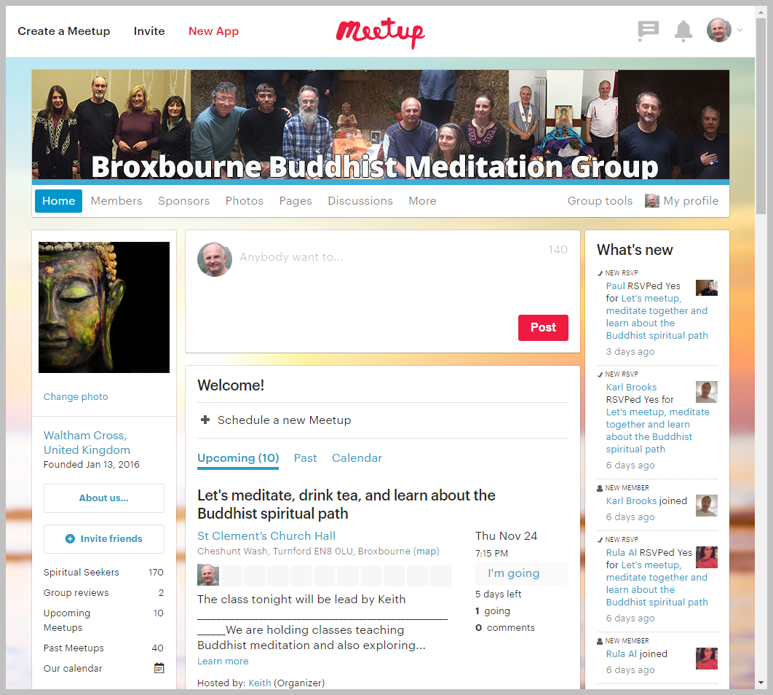
Suggested 4 point plan
Meetup.com
Best results for minimum time effort and money

Slide 18
Cost of Meetup
There is a cheaper basic plan at £8 per month for up to 50 members and 4 organisers, but you will soon outgrow that

Slide 19
Cost of Meetup
There is a cheaper basic plan at £8 per month for up to 50 members and 4 organisers, but you will soon outgrow that
You will soon need to upgrade to Unlimited plan $15 (approx. £12) per month. This gives unlimited members and organisers

Slide 20
Advantages of Meetup

Slide 21
Advantages of Meetup

Slide 22
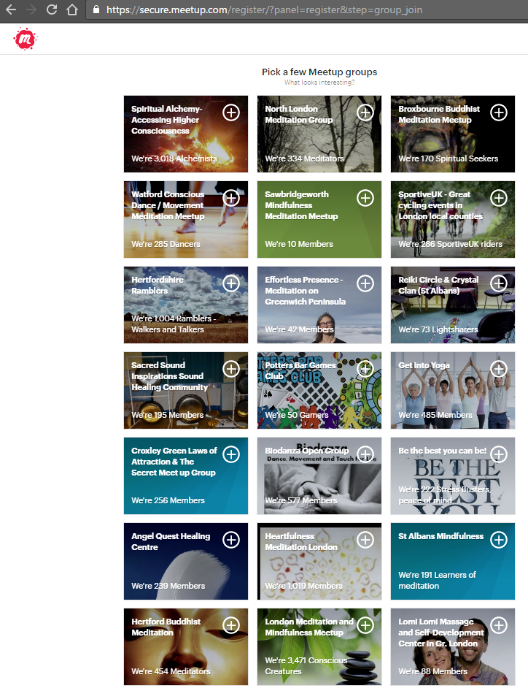
Advantages of Meetup
Many local people join meetup.com (which is free for them) and will search there for “meditation” or “Buddhism”

Slide 23
Advantages of Meetup
They might click on your group

Slide 24
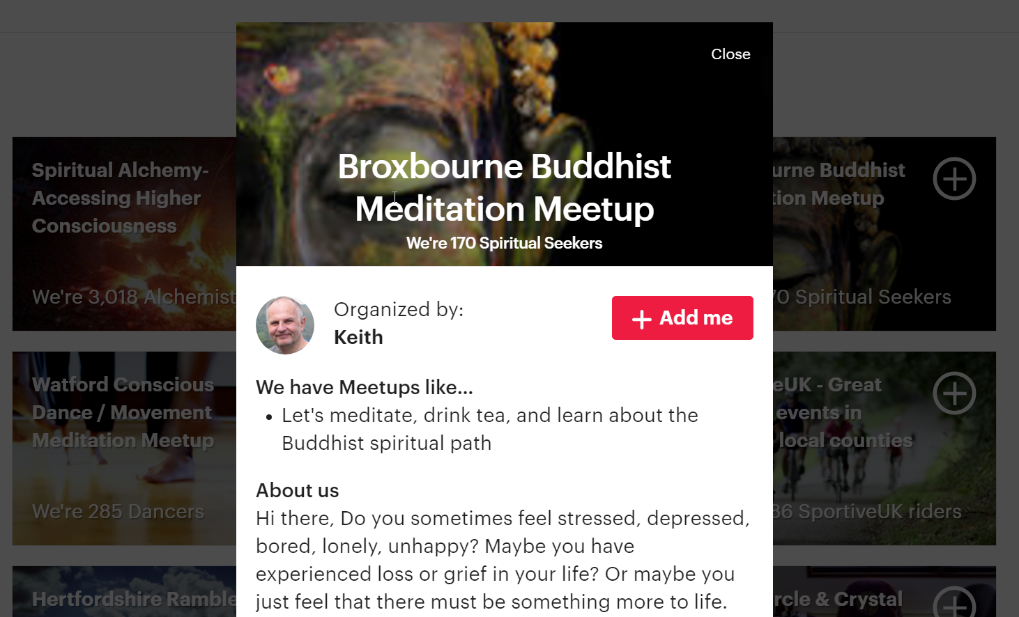
Advantages of Meetup
They then see your home page, and might click the red “add me” button

Slide 25
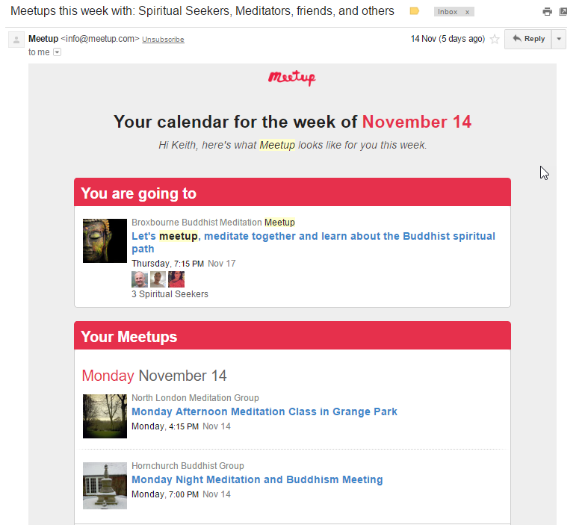
Advantages of Meetup
Then every week meetup.com will send them an email with a calandar reminding them of the events of the meetup groups they have joined

Slide 26
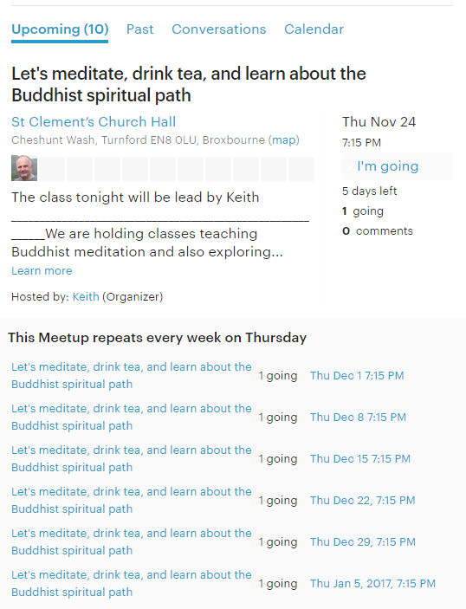
Advantages of Meetup
You write out information for one event, and it will automatically duplicate this infinite times, so you automatically have a page for every evening, which you can edit.
In other words, after you set it up, you hardly have to do any more work updating it.

Slide 27
Advantages of Meetup
People can easily click RSVP to an event, and then they can click on a photo and leave a message for people

Slide 28
Advantages of Meetup
Some people like to message me, which I always reply to
“Thank you for updating . I like the group so much that I would come even if there are 2 people. Just was not well n then got busy. Believe or not, I remember nearly every Thursday that I want to go and I end up not attending. I am missing the group for sure and will make effort to join in when back in London.”

Slide 29
Advantages of Meetup
It gives me a list of all our 170 members. You can search them or sort by name or date that they last visited the group page

Slide 30
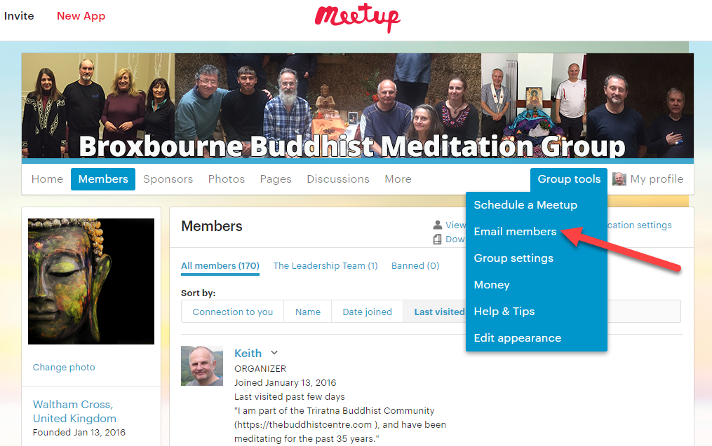
Advantages of Meetup
As well as messaging them individually, I can sent out a bulk email to all 170 members, which I do every month
This is under group tools

Slide 31
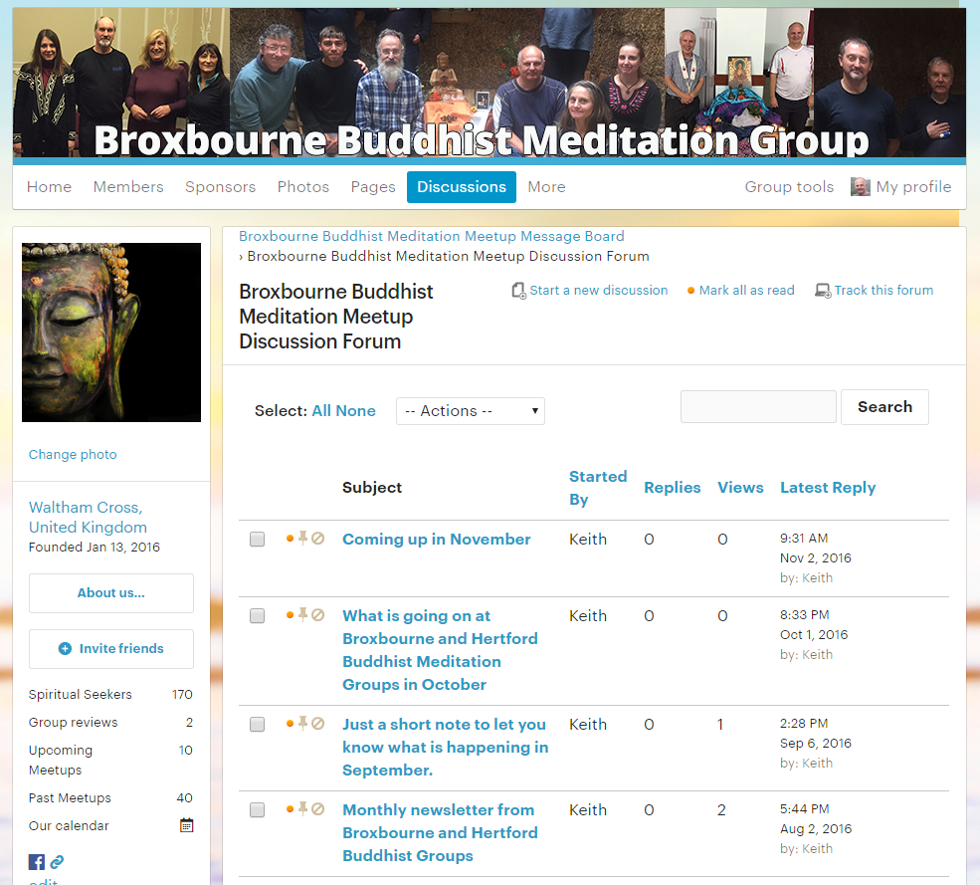
Advantages of Meetup
It also gives you a discussion forum, although we don’t actually use this.

Slide 32
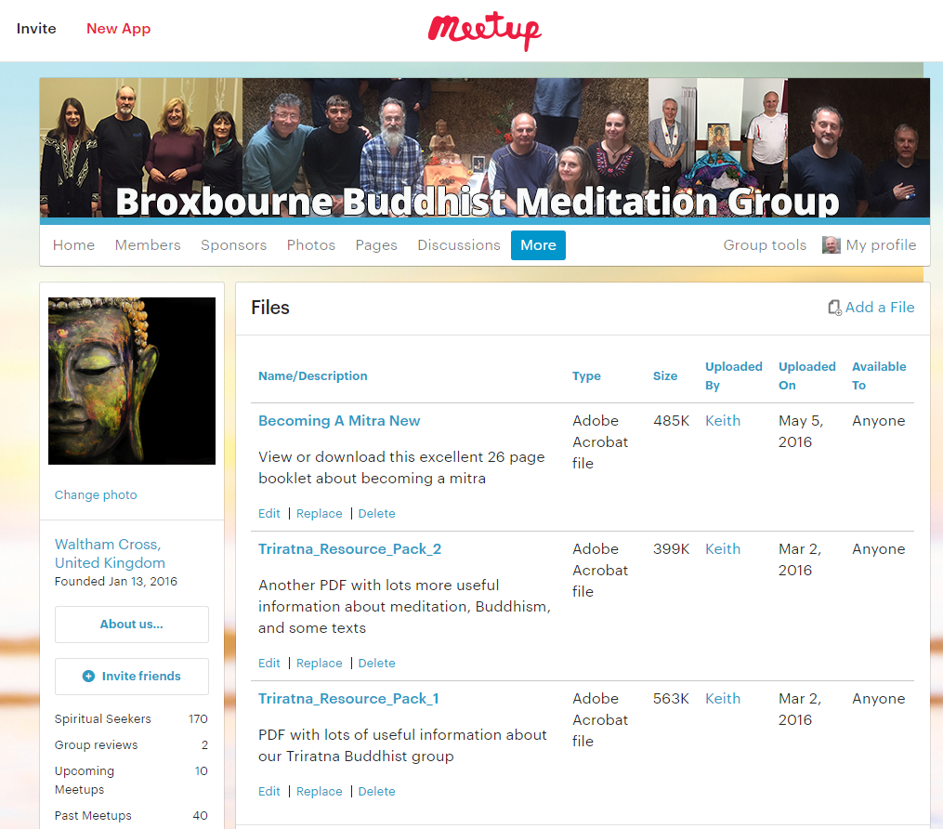
Advantages of Meetup
You can also upload files for people to download

Slide 33
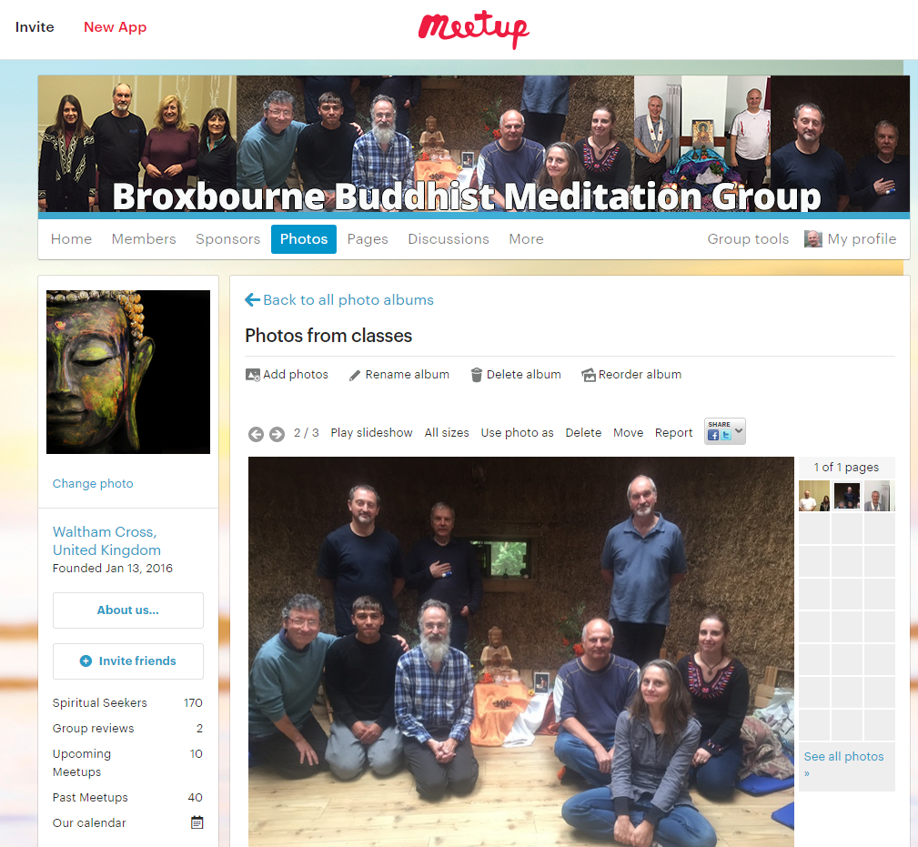
Advantages of Meetup
And add photos and pages

Slide 34
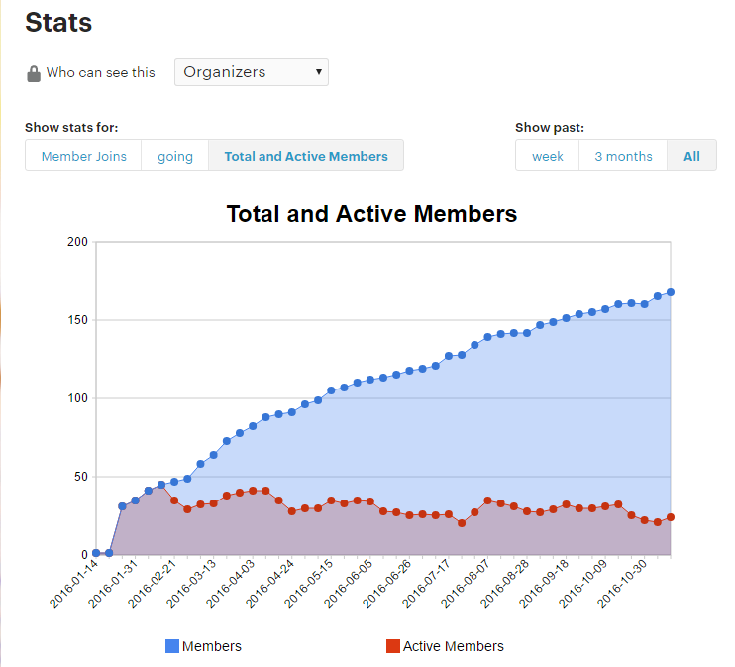
Advantages of Meetup
And give you a few nice graphs

Slide 35
Advantages of Meetup
In other words it is designed from the ground up exactly for small groups such as ours

Slide 36
Advantages of Meetup
Bottom line is that we get a lot of people from meetup, and many go on to become regulars.

Slide 37
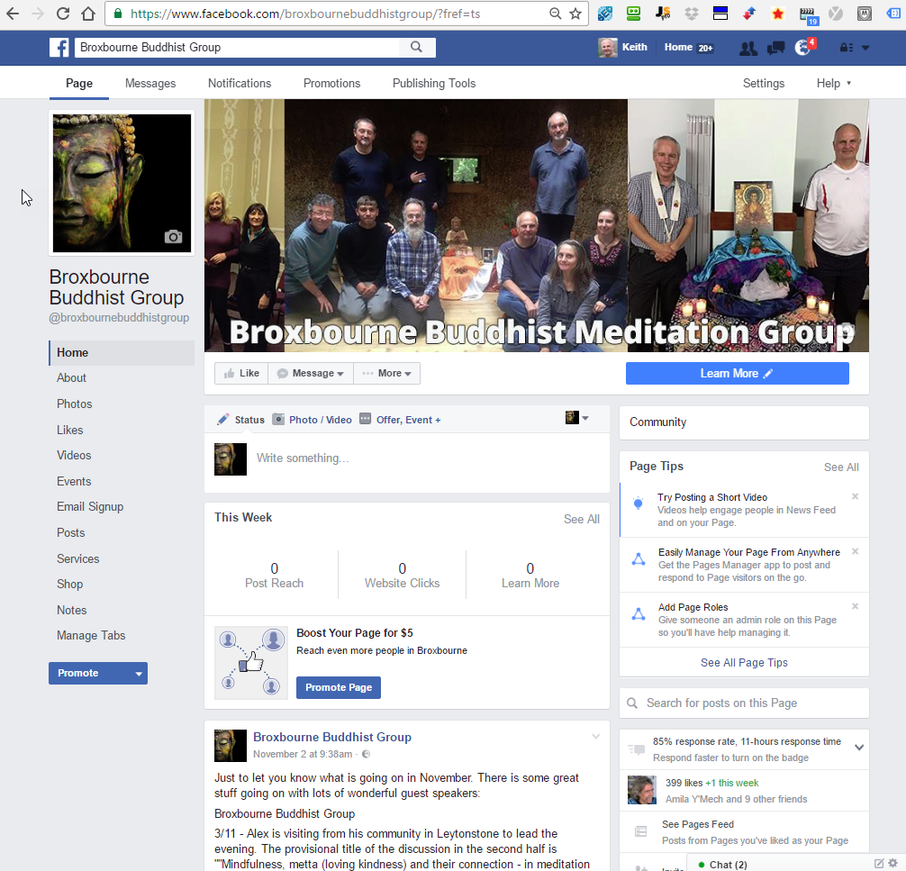
Suggested 4 point plan – step 2
2. Create Facebook Page

Slide 38
In Facebook the Difference between a “page” and a “group”
A group is a forum or discussion group
Eg East Kent Buddhist Sangha has a closed one with 37 members
“Closed” means an admin must approve you before you can see the posts
Kept closed for privacy and to create a safe space
People arrange lifts, post photos, and videos etc
It can be useful if you have several active Facebook users

Slide 39
But here we are talking about a Facebook “Page”
Used to be known as a “fan page”
Posts can only be created by admin – not by anyone
Therefore our page is open

Slide 40
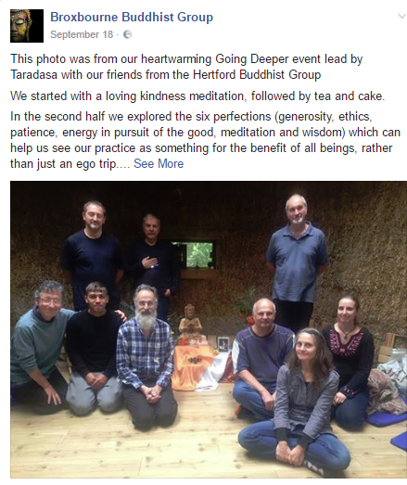
Facebook Page
Keep it updated with:
Posts with photos of events,

Slide 41
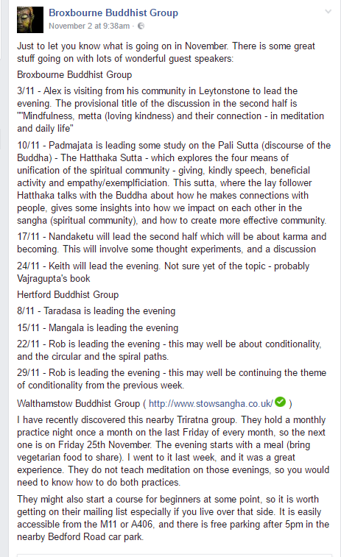
Facebook Page
Keep it updated with:
Posts with photos of events,
What is coming up at your group

Slide 42
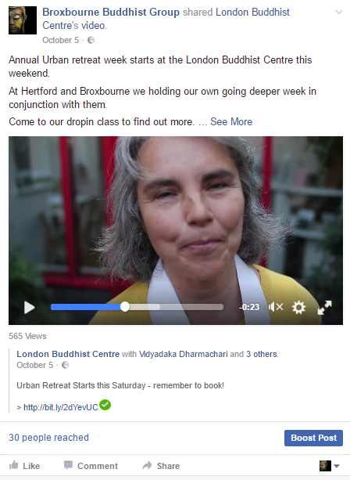
Facebook Page
Keep it updated with:
Posts with photos of events,
What is coming up at your group
Shares from other Triratna pages including youtube

Slide 43
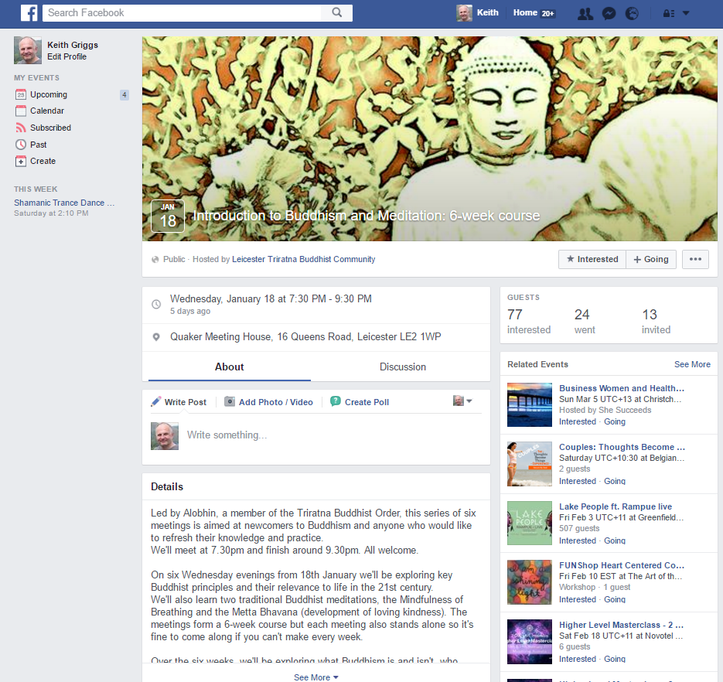
Facebook Page
Keep it updated with:
Posts with photos of events,
What is coming up at your group
Shares from other Triratna pages including youtube
Can create an “event”. These do extremely well when boosted.

Slide 44
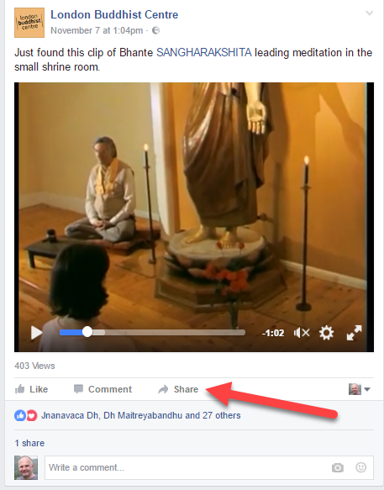
Facebook Page
Keep an eye on other Triratna Facebook pages and Youtube videos, and anything with a lot of engagement (shares, likes and comments), you can consider sharing onto your page (not onto your personal timeline)

Slide 45
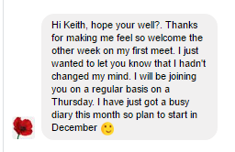
Facebook Page
People can and do message you on Facebook

Slide 46
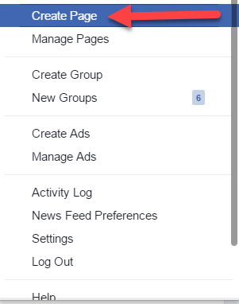
How to set up a Facebook Page
It is very easy, and also free
Just google or search on youtube “how to set up a facebook page”
Or click triangle
And then “create page”

Slide 47
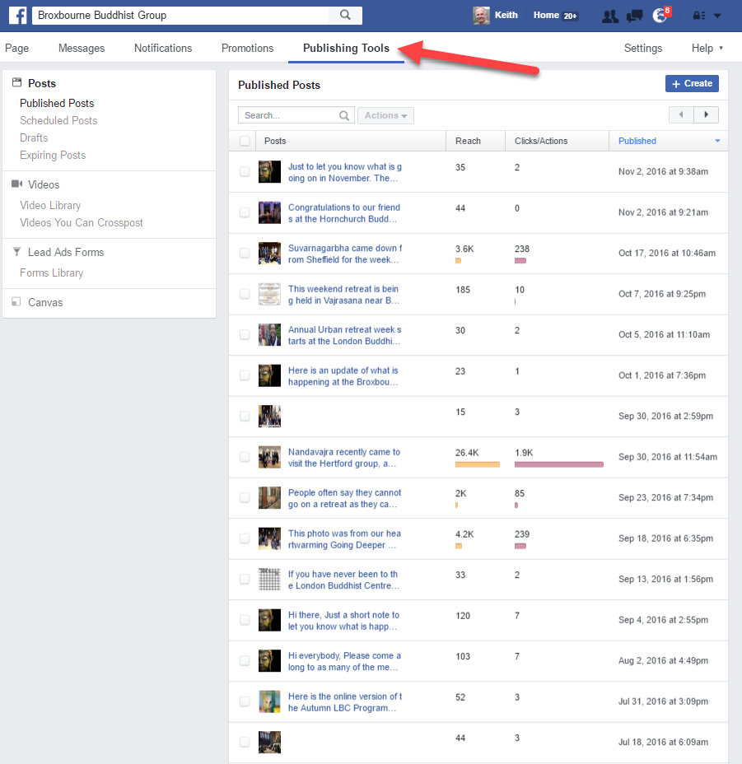
Facebook Page
Under publishing tools, it shows reach and clicks/actions for each post, so you can find out which type of post gets best engagement

Slide 48
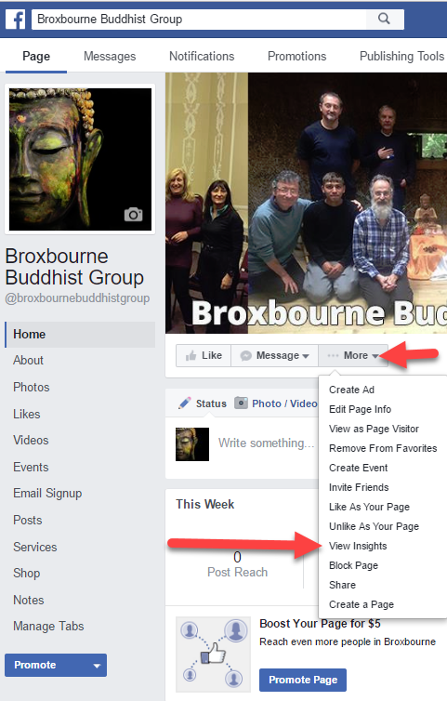
Facebook Page
If you like graphs and stats, then click more, view insights

Slide 49
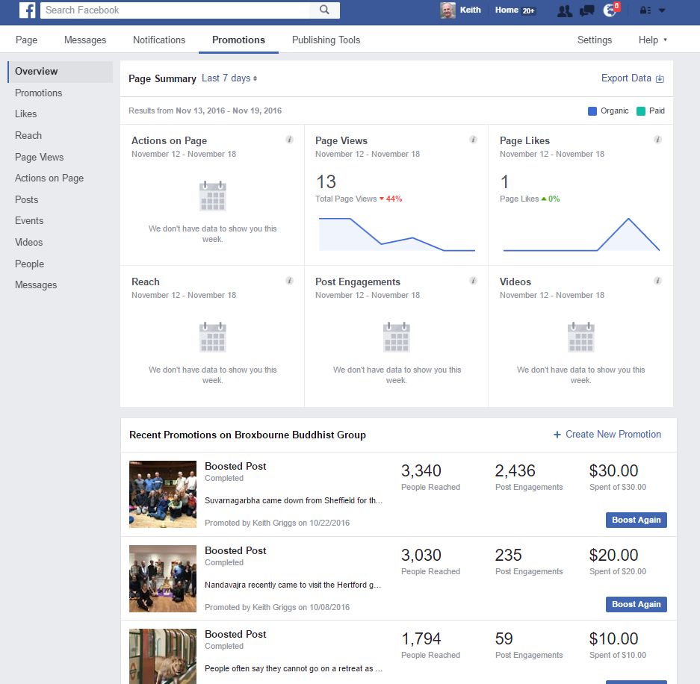
Facebook Page
Screenshot shows the overview
Click on each of the items in the left hand navigation bar
My favourite is “people”

Slide 50
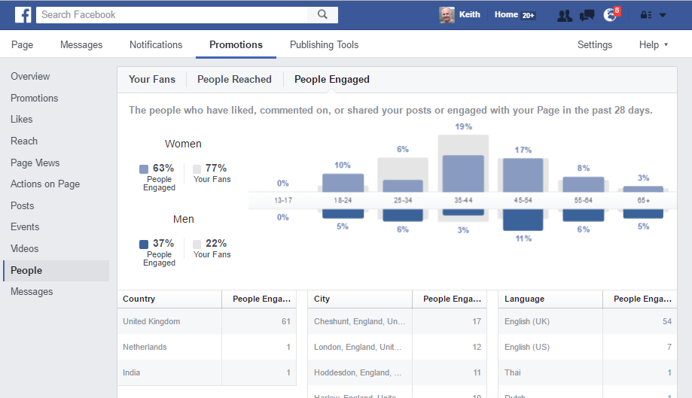
Facebook Page
The “people” tab on the left in the insights section shows where people live, and what gender age they are
Graph shows we are doing particularly well with women aged between 45 and 54
Mostly local, although one fan in India, and another in the Netherlands

Slide 51
Suggested 4 point plan – step 3 (optional)
If a post has high engagement (clicks, likes, comments and shares) then pay Facebook to boost it
The fact it has high engagement means it will be cheaper, and you can therefore reach more people

Slide 52
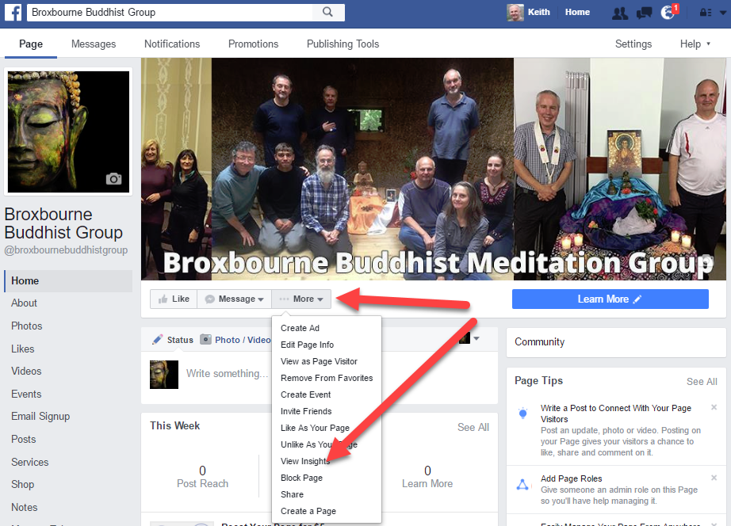
Find out which posts have high engagement
Click “More”
Then click “View Insights”

Slide 53
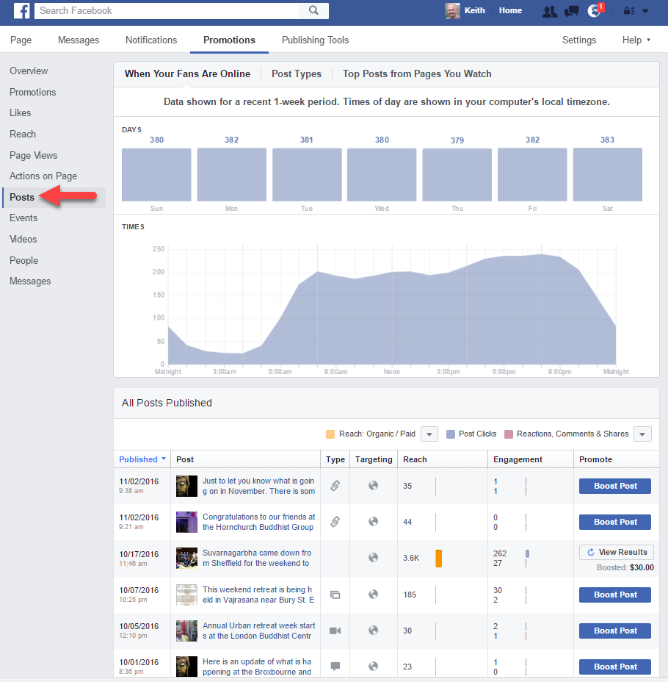
Find out which posts have high engagement
Click “Posts” on left,
then scroll down

Slide 54
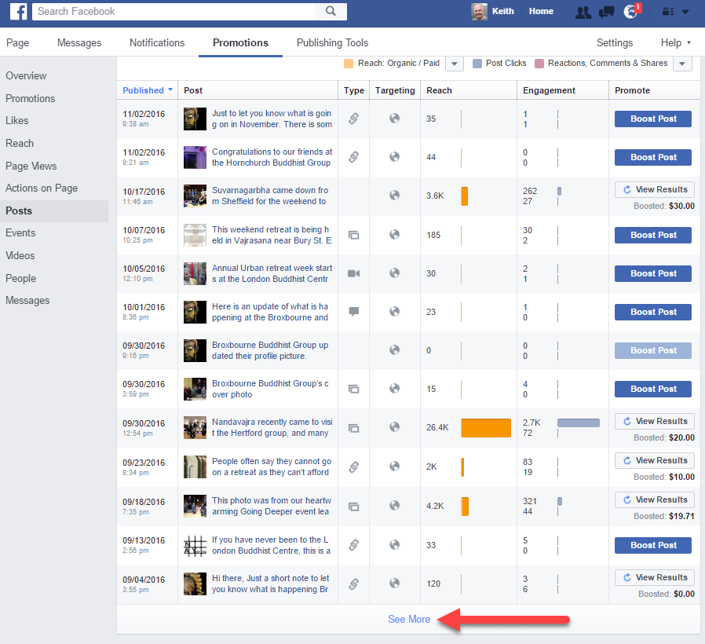
Find out which posts have high engagement
Click “See More” at bottom of the page

Slide 55
Find out which posts have high engagement
Table shows all your posts with reach and engagement (clicks, comments, likes and shares)

Slide 56
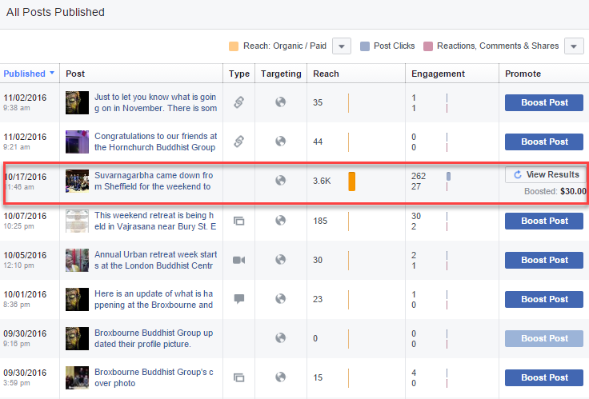
Find a post with high engagement then boost

Slide 57
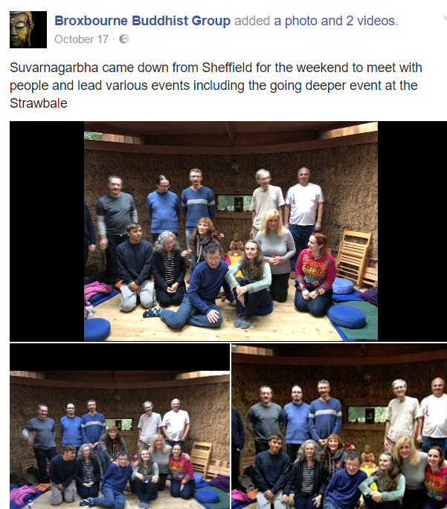
Reason this post had high engagement
It had a three second video which was taken on a new iphone with “live function”.
- Drew the gaze
- Conveyed joyous spirit of the sangha

Slide 58
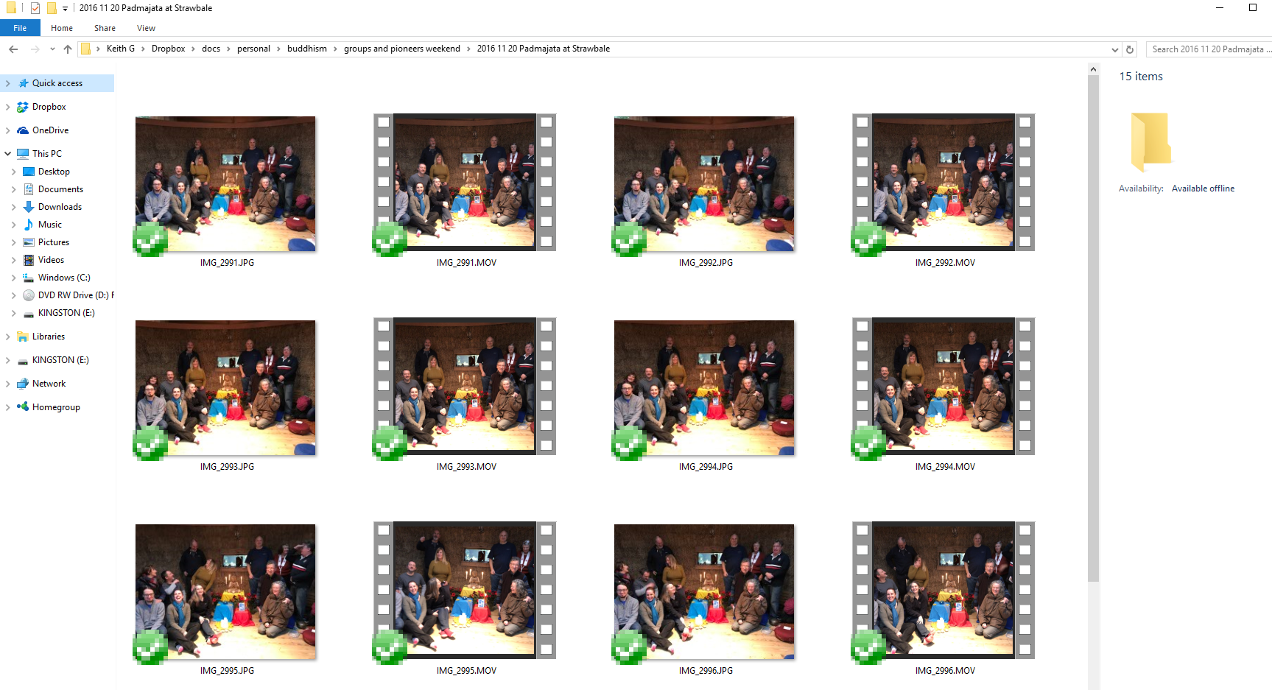
Plug iphone into PC and see video and picture files together in file manager

Slide 59
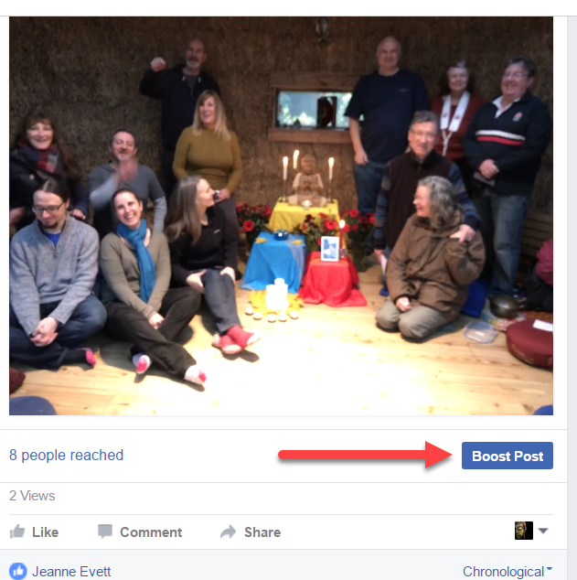
How to Boost a Post
Click the “boost post” button on the post

Slide 60
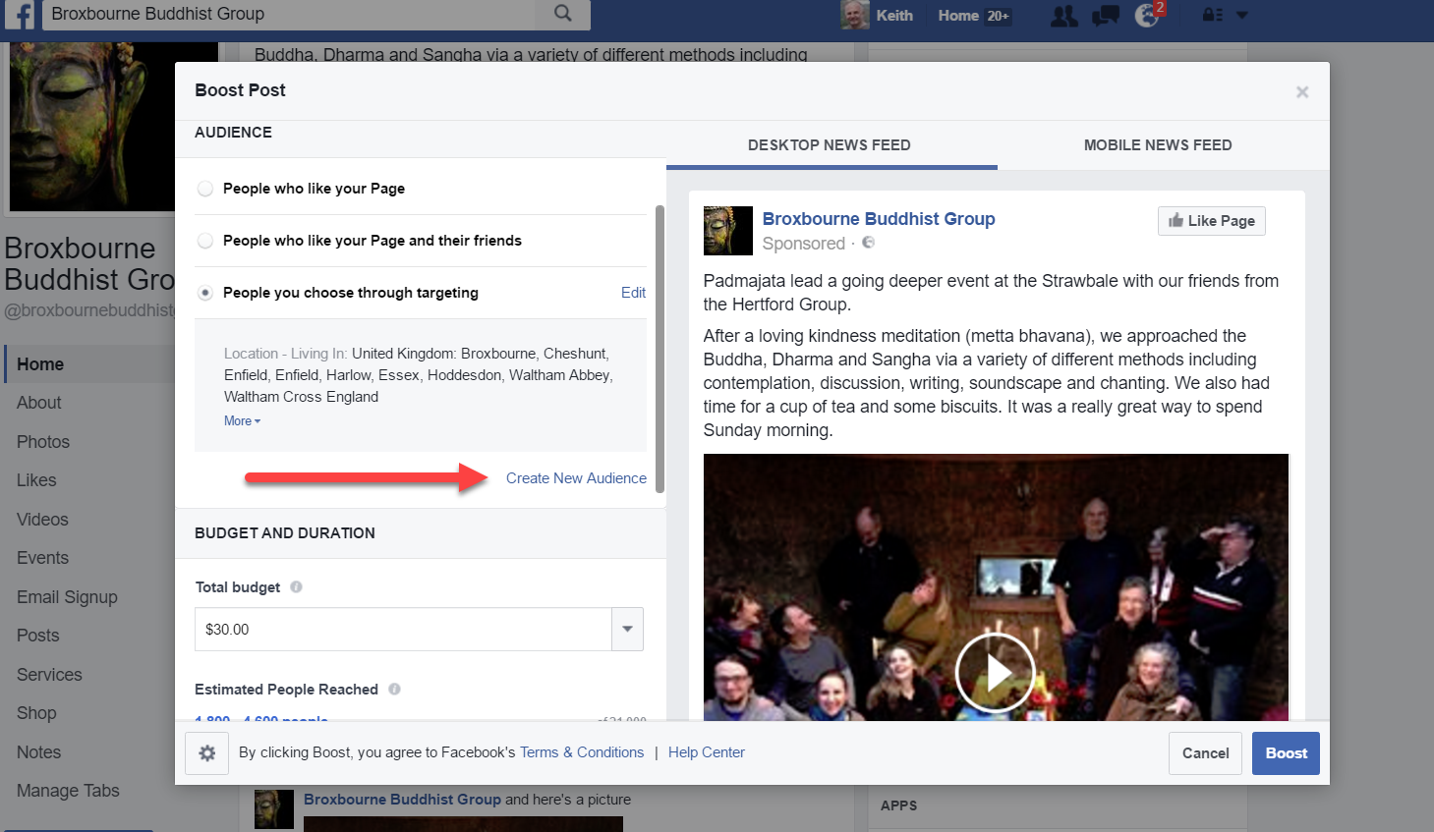
How to Boost a Post
Create new audience
(or use or edit previous one)

Slide 61
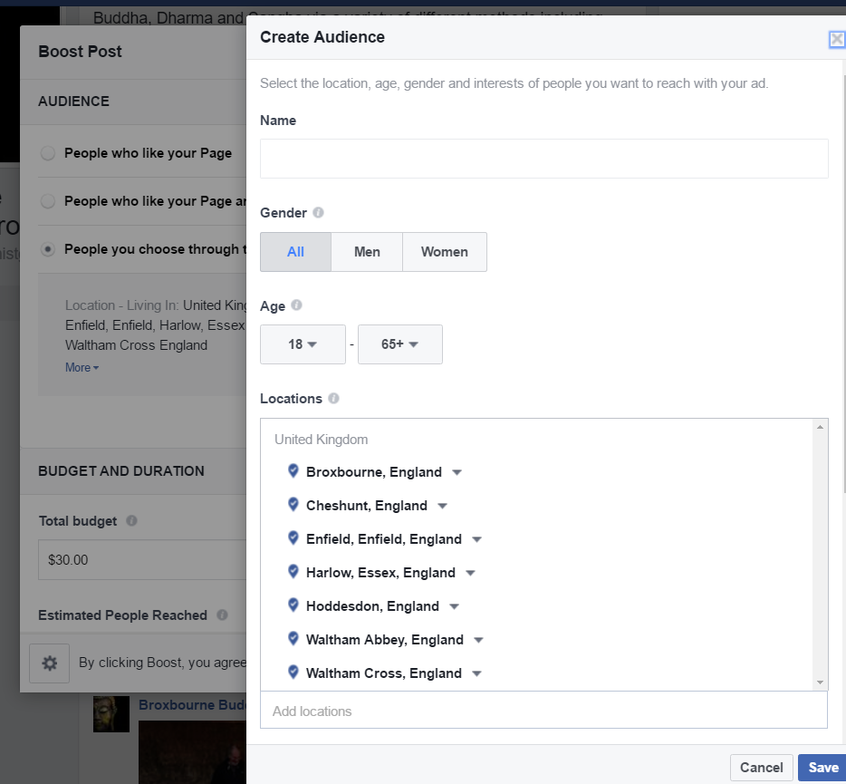
How to Boost a Post
You can select gender, age. I personally include everyone 18+
I only select locations where our regulars actually come from. This is within about a twenty minute drive.

Slide 62
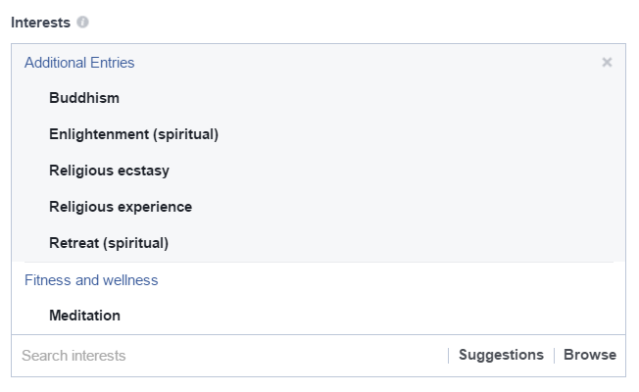
How to Boost a Post
I only show the ad to people with the interests on the right.
If you include other interests, people will click who will not be motivated enough to come.
That would waste you money.
But you can split test this. Boost a post twice for small amounts of money ($5), do first for people interested in say “mindfulness”, and the second for those interested in “yoga”, and note the engagements for each one. This is easier in the Facebook ads manager, but that is outside the scope of this talk.

Slide 63
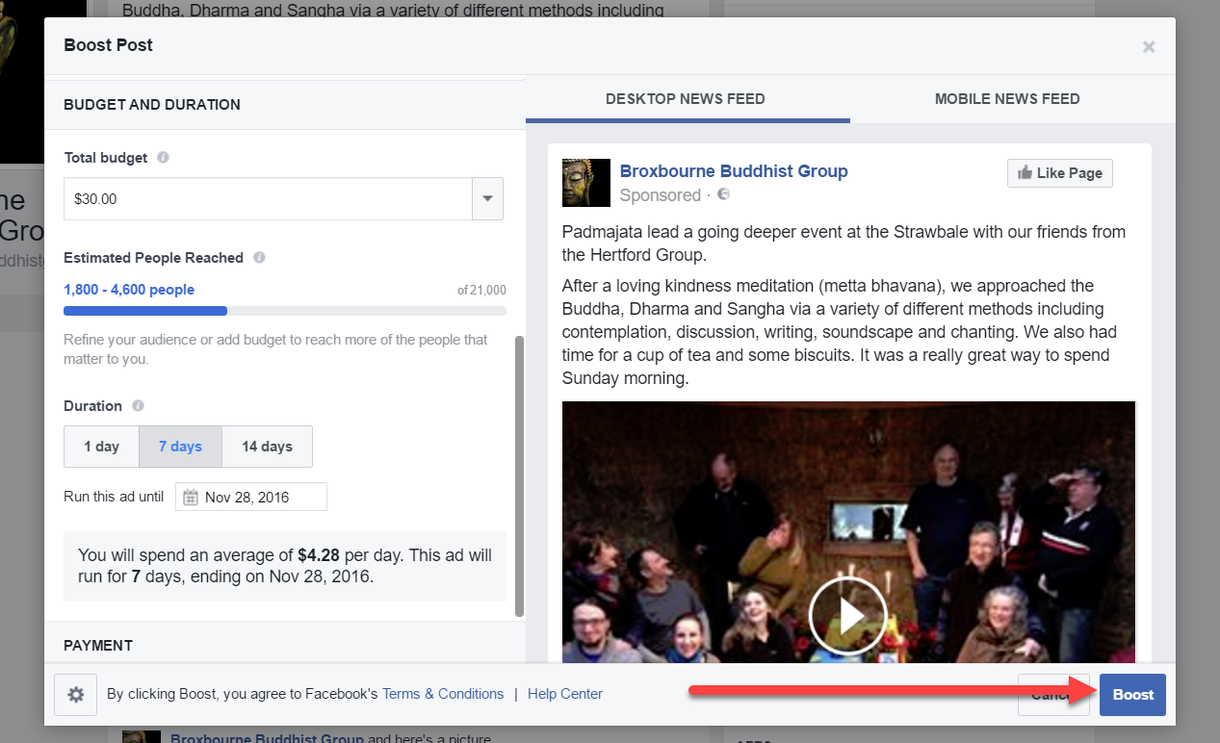
How to Boost a Post
Set amount, duration,
add credit card, and click the “Boost” button

Slide 64
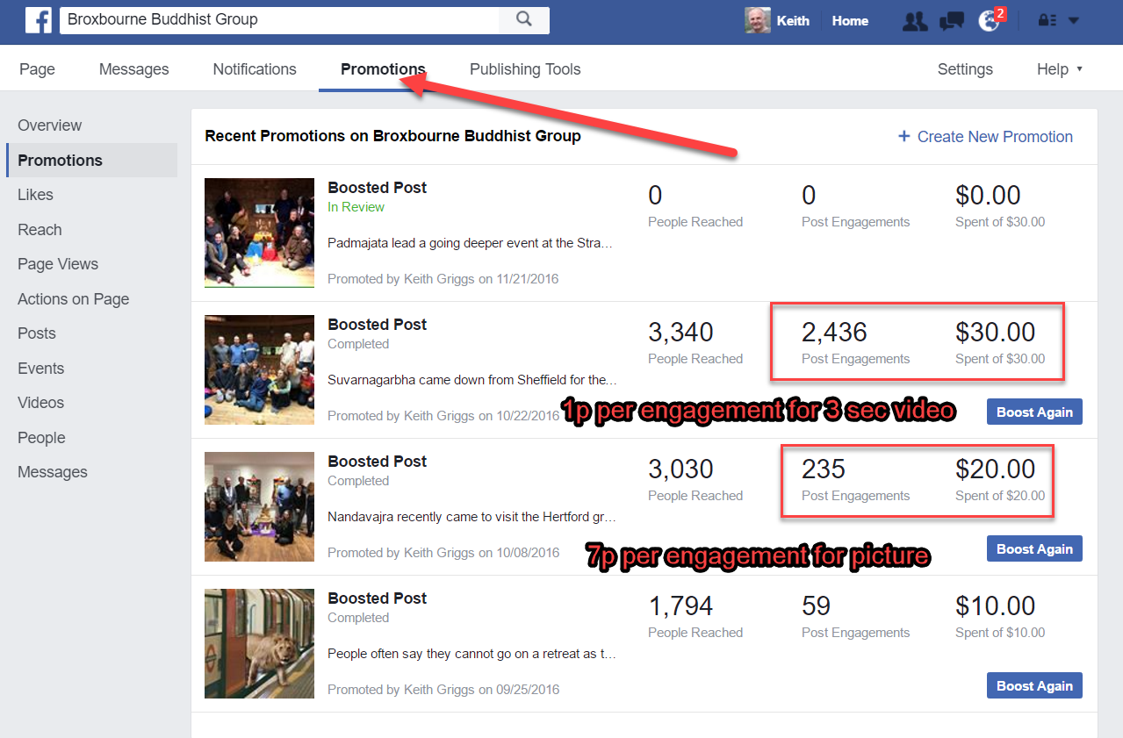
Results of previous boosts
Click promotions
Post of Suvarnagarbha’s visit (a 3 second video) got 2,436 engagements for $30. This is 1p each engagement
Post of Nandavajra’s visit(a picture) got 235 engagements for $20. This is 7p per engagement.
Conclusion – always use videos when you can, especially of people laughing and moving around

Slide 65
Cost $20 Likes 45 Engagements 109 reached 3,014 people Gandhara Picture bought from thinkstockphotos.co.uk for £5

Slide 66
Cheapest per engagement were videos at 1 cent, then photo of sangha at 9c, then photo of the Buddha at 18c. Therefore, best to use videos.

Slide 67
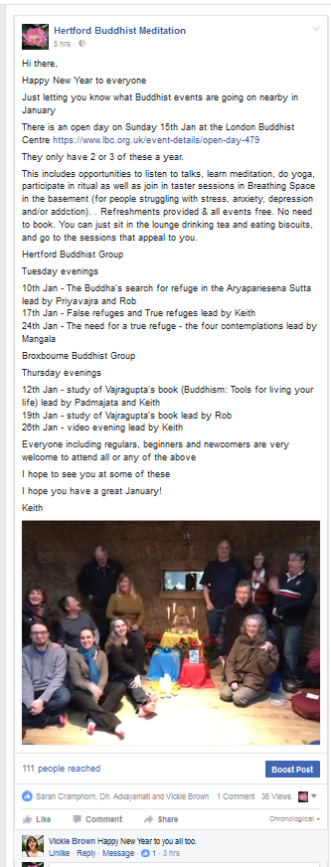
Top tip
Take one very short video each month at the end of a popular event.
When you post it, include in the same post everything that is coming up in the next month
Boost it
That way more people will see what is coming up

Slide 68
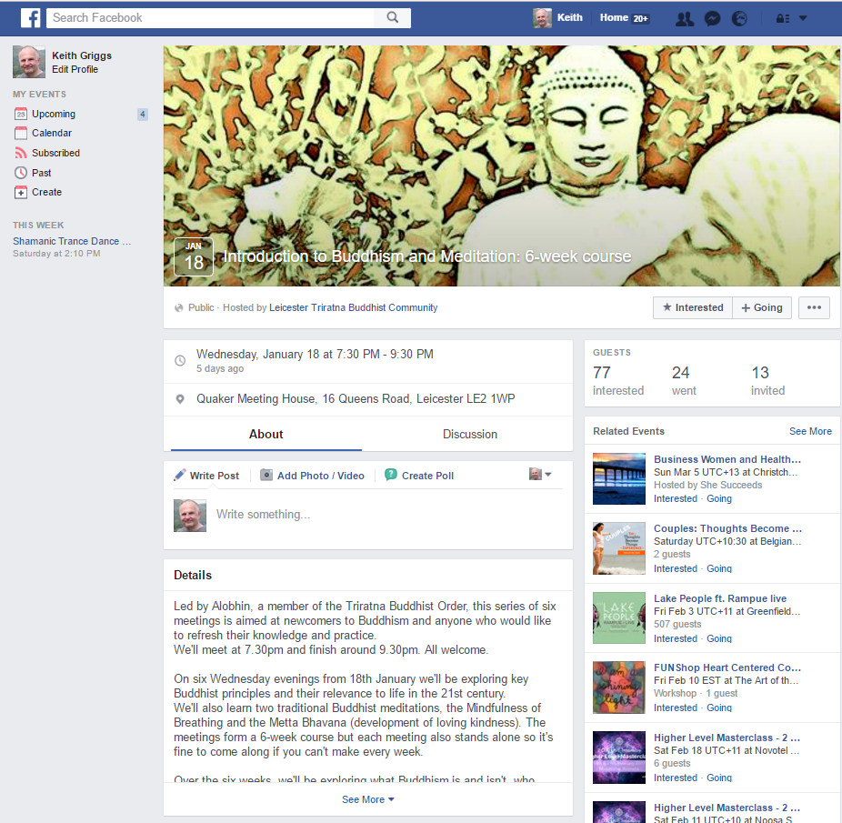
Step 4 Create Facebook event and boost it
Pippa from Leicester got an AMAZING result this way
She paid £1 a day for 20 days = total of £20
She got 20 people enrolling for this course
This is the best return on investment we have seen and it is HIGHLY RECOMMENDED that you try it

Slide 69
Step 5: www.thebuddhistcentre.com
Email support@thebuddhistcentre.com and ask them to list your group and either:
1) ask them to create a page for you there (if you don’t want to bother with wordpress or blogger etc)
OR
2) if you don’t want them to create a page, then get a link from them to your main site. This will boost it in Google

Slide 70
Alternative to wordpress and blogger is to get a page at thebuddhistcentre.com
You need to identify someone who will keep it updated (preferably an order member)
Email support@thebuddhistcentre.com to get a page, and to ask for assistance
Example of it done well is the now defunct Glastonbury Buddhist Group - thebuddhistcentre.com/glastonbury

Slide 71
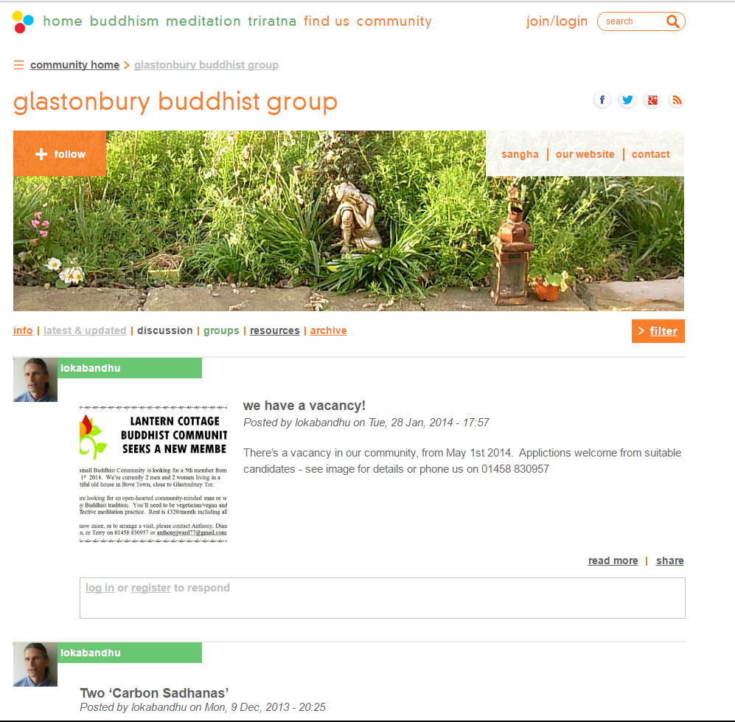

Slide 72
If you do NOT want a thebuddhistcentre.com page
Then email support@thebuddhistcentre.com and ask them to list your main website or meetup page
Means people can find you from thebuddhistcentre.com
thebuddhistcentre.com is a very strong domain, so being listed gives you a powerful link which will boost your ranking in Google

Slide 73
Step 6 (optional). Create website or blog
This is not absolutely necessary, as you can do a lot of things on your meetup and facebook pages
But advantages are:
You get another slot in Google
You have more control over the site, and how it is presented.
It gives your group more perceived authority as it has its own domain eg broxbournebuddhistgroup.co.uk

Slide 74
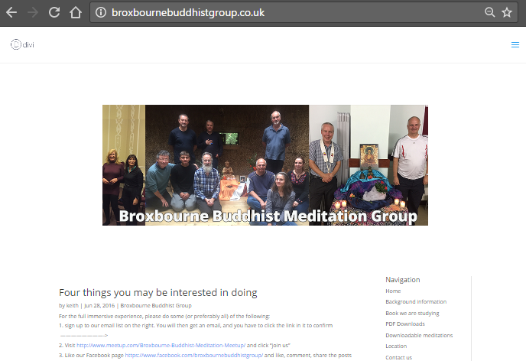
This is our blog created in wordpress

Slide 75
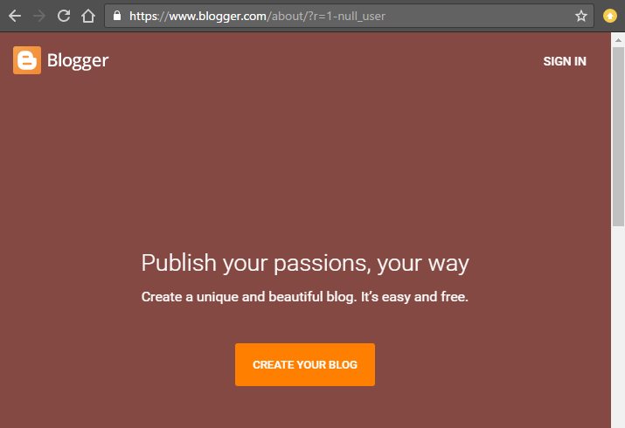
Easier alternative is to use blogspot (aka blogger)
This is owned by Google
Totally free
Pretty easy to do
You create it at blogger.com, and it shows up at blogspot.com

Slide 76
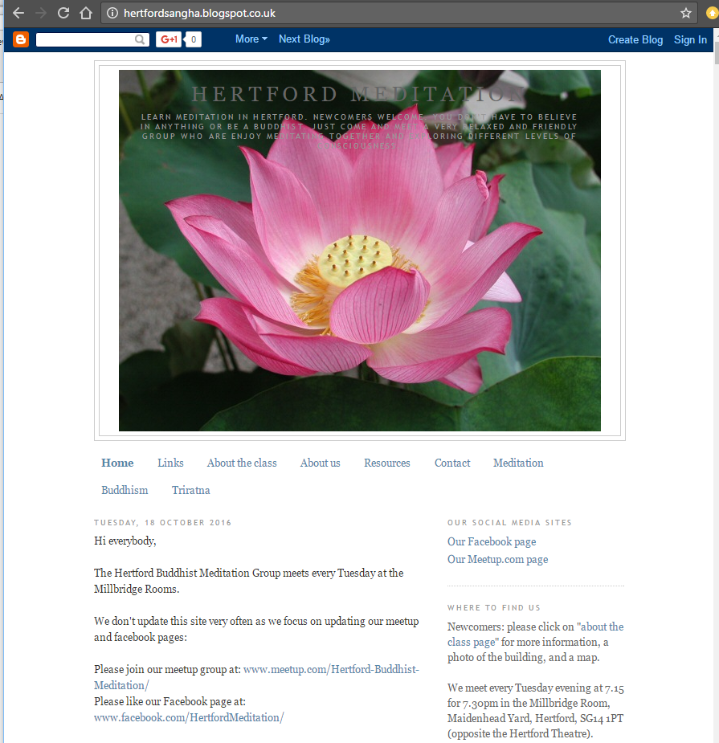
Blogspot / blogger
Hertford has a blog created here
hertfordsangha.blogspot.co.uk

Slide 77
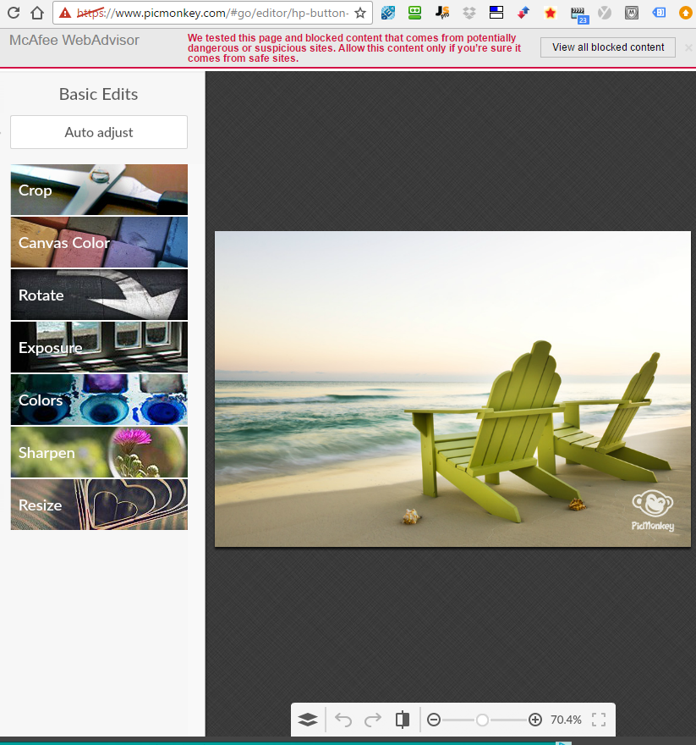
Top tip for editing graphics = picmonkey.com
You can easily
upload a photo,
crop,
resize,
add text etc.
All free

Slide 78
Canva great for facebook posts with text

Slide 79
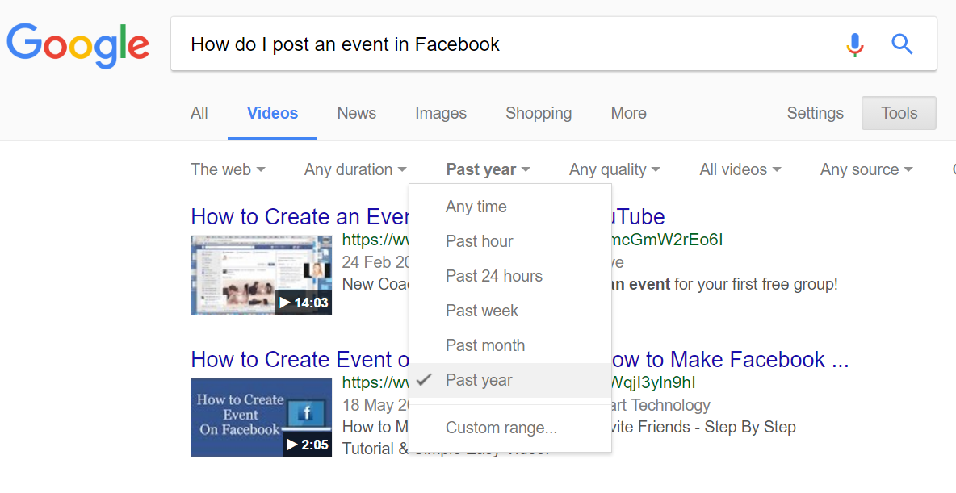
Top tip: If you have any question about Facebook , Meetup or almost anything else
Google the question, just as you would ask it in real life eg “How do I post an event in Facebook”
Then click videos, tools, any time, past year
This gives recent videos answering your question

Slide 80
Good luck
and
The End

